Slide 1
Testbourne Limited
Company Presentation

Slide 2
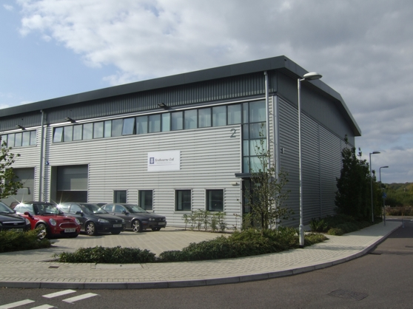

Company Overview
Family own business established by Ted and Jill Mihill in 1977
Became a limited company in 1979
Location: Basingstoke, Hampshire
Over 3000 customers worldwide

Slide 3
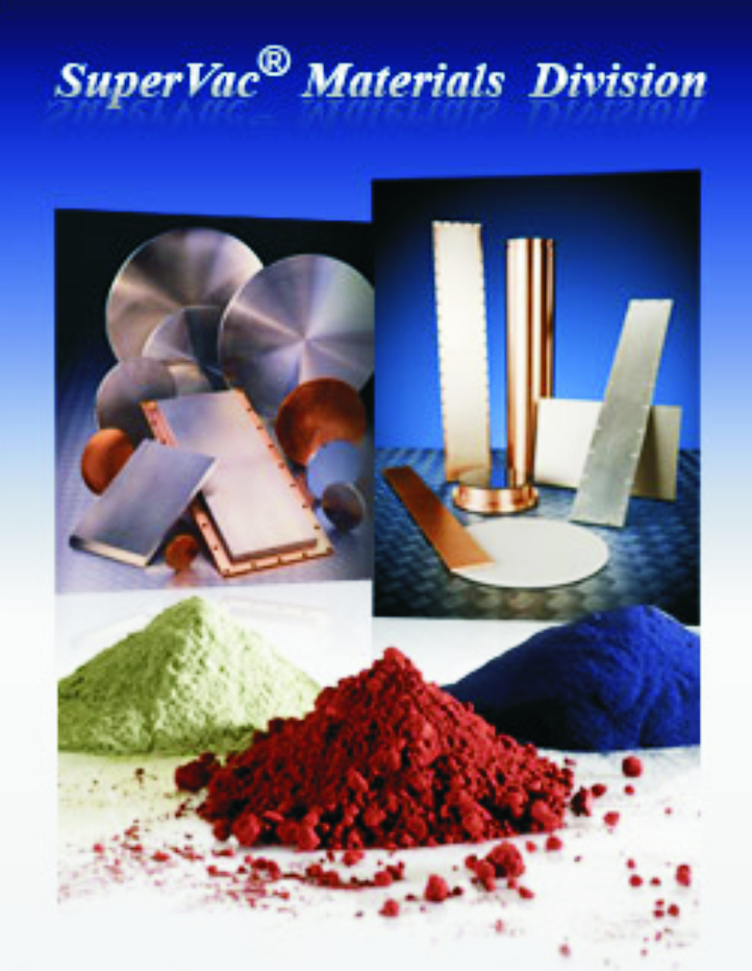

Testbourne Divisions
The company is split in to two divisions:
  SuperVac® Materials Division:
    This division represents an extensive selection of materials available in fabricated forms including sputtering targets, evaporation materials, powders, wire, rods & sheets.
  Instrument Division:
    Testbourne Limited is the representative for some of the world's leading scientific instrument manufacturers that include QCM technology, Sample Preparation Equipment, Microwave and Radio Frequency Systems, UHV components and Thin Film Technology.

Slide 4
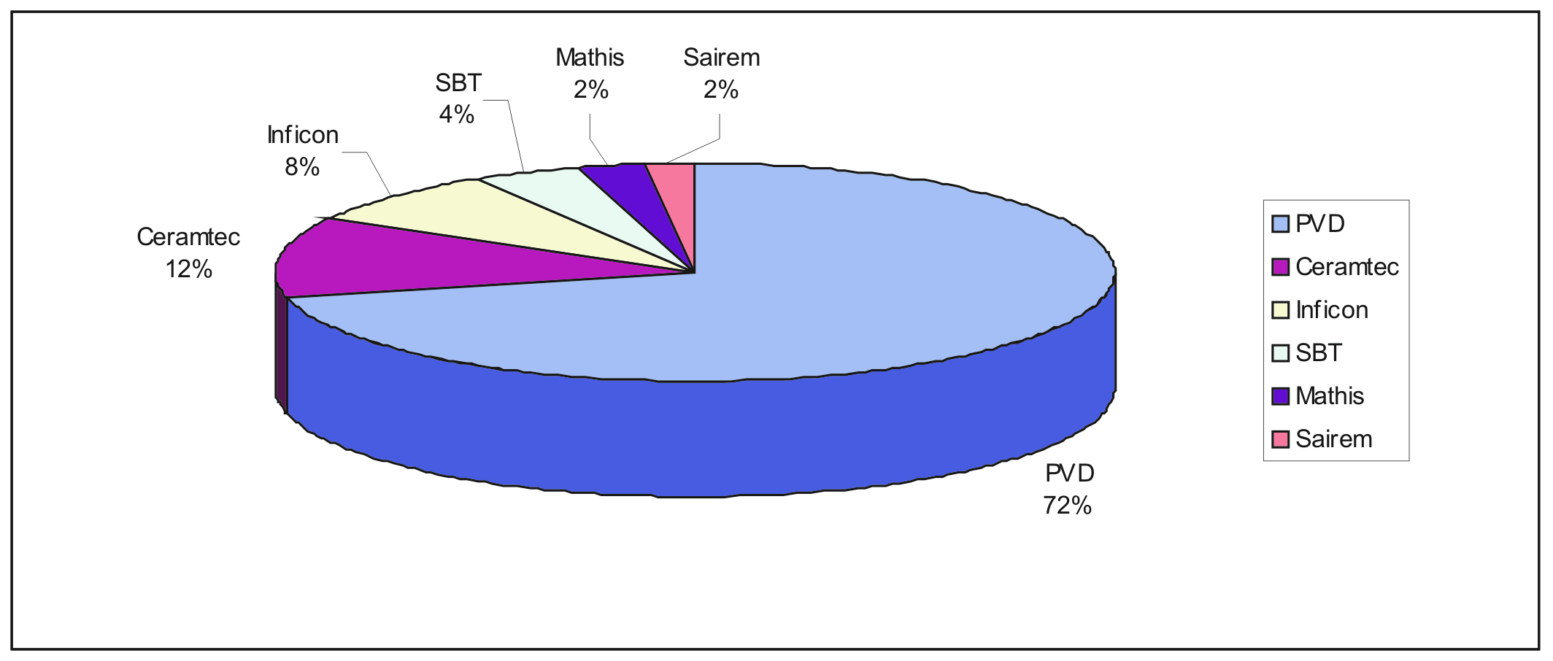
Sales Distribution by Product

Slide 5
Industries Served
Photovoltaic (Solar)
Ophthalmic
Architectural and Automotive Glass Coating
LED/OLED
Decorative and Hardwearing Coatings
Medical
Military
Aerospace
Semiconductor
R&D Research Establishments and Universities

Slide 6
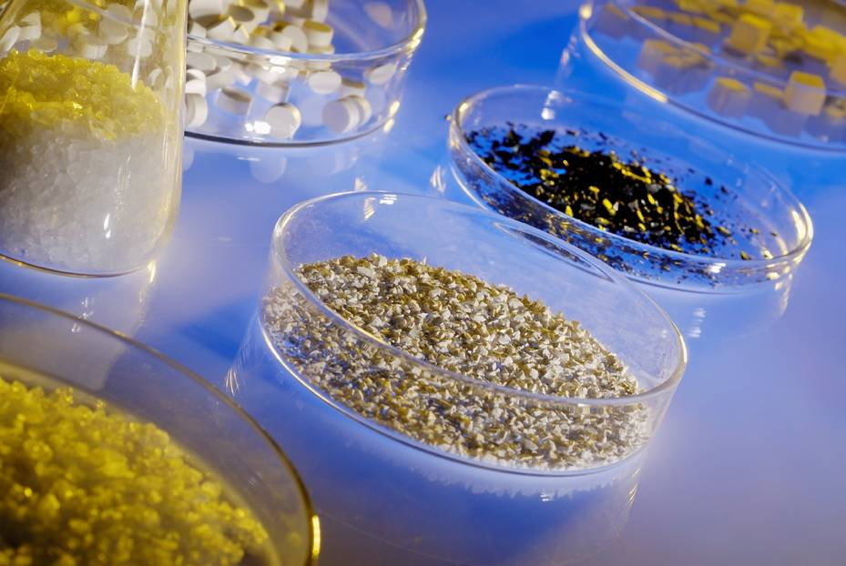
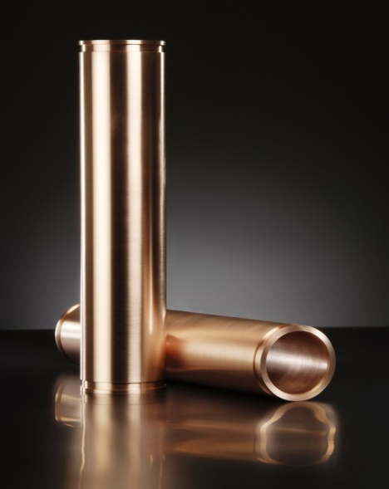
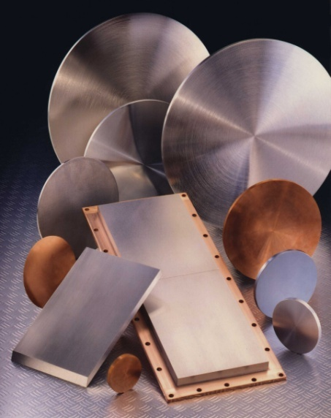
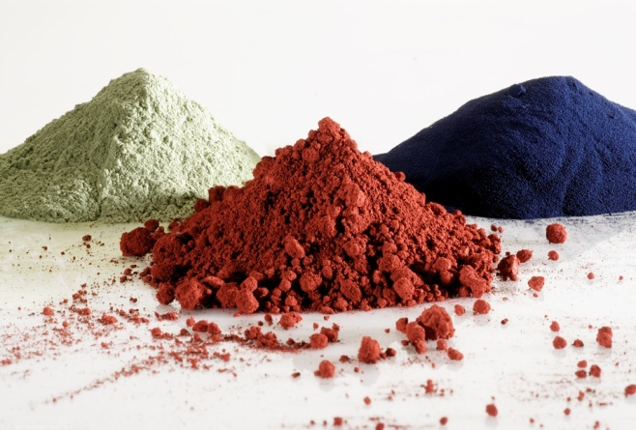
Materials Division Manufacturing Capabilities
Metal and Alloy Planar and Circular Sputter Targets
  Vacuum Melt
  Hot Isostatic Press.
Metal and Alloy Rotatable Sputter Targets
  Plasma Spray
  Cast Mould
Precious Metal Reclaim
Compound Sputter Targets
  Sintering
  Hot Powder Press
SuperVac® Materials
  Sintering
  Vacuum Melting
  Crystal Growing

Slide 7
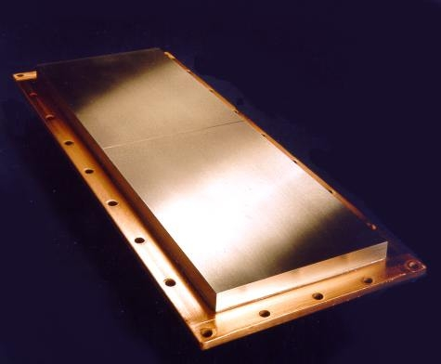
Target Bonding and Backing Plates
Indium Based Metallic Bonding
  can withstand temperatures up to 156 °C.
  The thermal conductivity of the bond is 83.7W/mK at 0 °C
Elastomer Bonding
  will operate at 250 °C
  has less than 1% total mass change at 250 °C for 24hrs at 1x10-7 Torr
  The thermal conductivity of the bond is 54W/mK at 0 °C
Silver-filled Epoxy Bonding Kits
Oxygen free, high conductivity (OFHC) Copper, Titanium, Aluminium, Molybdenum and Stainless Steel Backing Plates.

Slide 8
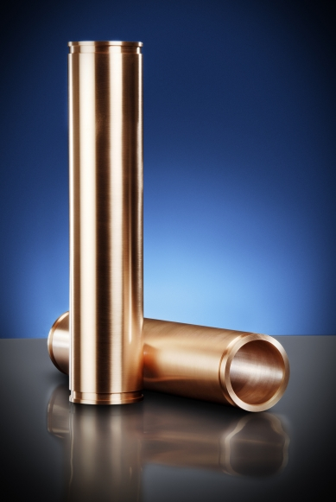
SuperVac® Metal Sputtering Targets for Photovoltaics Industry
Aluminium, Al
Chromium, Cr
Copper, Cu
Indium, In
Molybdenum, Mo
Niobium, Nb
Nickel, Ni
Silicon, Si
Tantalum, Ta
Tin, Sn
Titanium, Ti
Tungsten, W
Zinc, Zn
Zirconium, Zr etc.

Slide 9

SuperVac® Compound Targets for Photovoltaics Industry
Aluminium oxide, Al2O3
Cadmium Sulphide, CdSe
Cadmium Telluride, CdTe
Indium, Gallium & Copper Selenides
Indium Tin oxide (ITO)
Silicon dioxide, SiO2
Titanium oxide TiOx
Zinc oxide, ZnO
Zinc oxide-Aluminium oxide (AZO)
Zinc oxide-Gallium oxide (GZO) etc.

Slide 10
SuperVac® Targets for Guardian
Nb/Zr Brazil
Nb/Zr UAE
C22 Qualification Brazil
Ti/Ni 20% Qualification DeWitt USA
Ti/Ni 50% Qualification DeWitt USA
Nb205 Qualification request Hungary

Slide 11
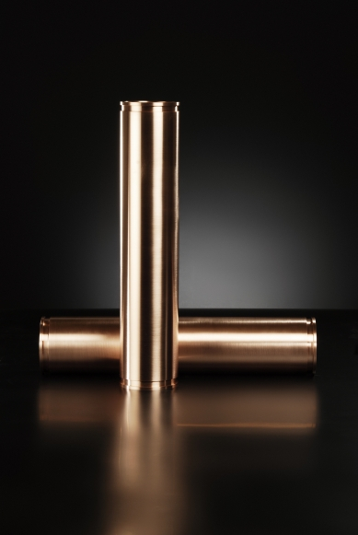
SuperVac® Alloy Sputtering Targets for Photovoltaics Industry
Cd-Sn
Cu-In-Ga
Cu-In-Ga-Se
In-Sn
Ni-V
Si-Al
Ti-Al
Zn-Al
Zn-Sn
Zn-Sn-Sb etc.

Slide 12
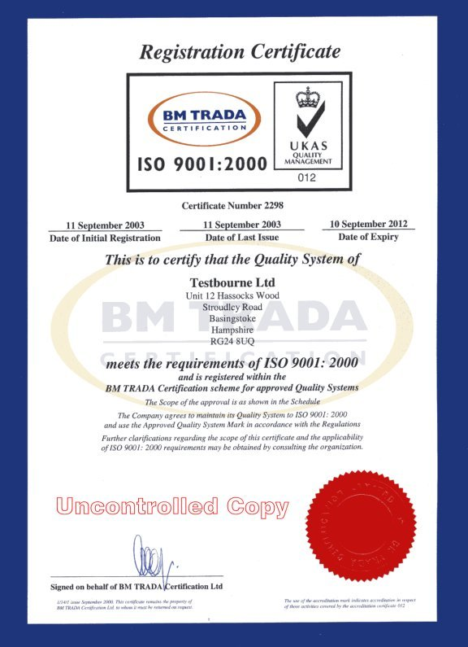
Analytical Capabilities and
Quality System
Inductively Coupled Plasma Spectroscopy (ICP):
  Most suited for determining ratios of the bulk materials in an alloy
    Relevant Items for ICP Analysis:
      High purity materials
      Sputtering Targets
      Metal alloys
Glow-Discharge Mass Spectrometry (GDMS):
  Most suited for determining the metallic impurities
    Relevant Items for GDMS Analysis:
      Sputtering Targets
      Metals including refractory metals and alloys
      High purity materials
      Rare earth metals and their oxides
      Precious Metals

Slide 13
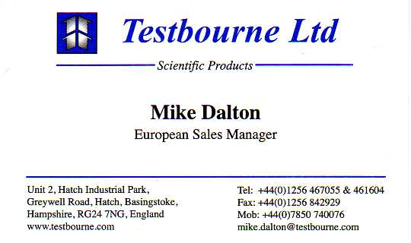
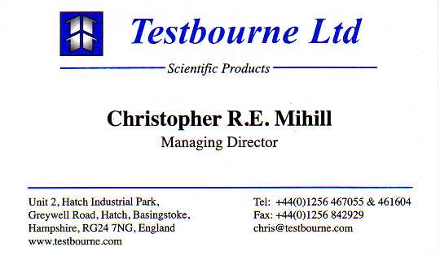
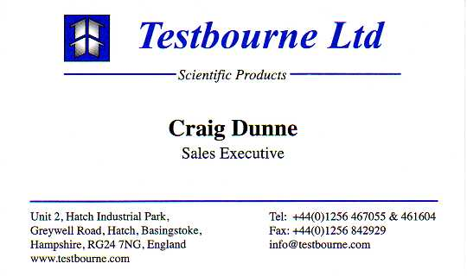
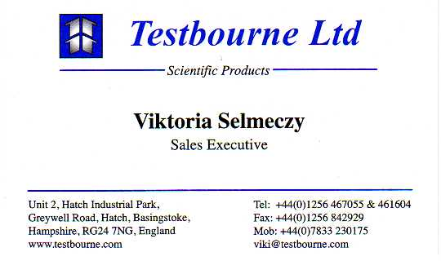
Sales Team

